Slide 1

ORCID and SAFIRE Integration
ORCID South Africa Workshop Johannesburg, October 2017
orcid.org/0000-0002-9388-8592

Slide 2
What is SAFIRE?
Integrating SAFIRE with ORCID
Integrating ORCID with SAFIRE
Further possibilities

Slide 3
What is SAFIRE?

Slide 4

Notes:
Should be self obvious, but probably not to this audience.

Slide 5
Identity Federations
A brief introduction

Slide 6
Federated Identity
A federated identity in information technology is the means of linking a person's electronic identity and attributes, stored across multiple distinct identity management systems
https://en.wikipedia.org/wiki/Federated_identity
Notes:
Explain the concepts of identity, attributes, and identity management systems

Slide 7



Federated Identity
Identity Providers
(Home Organisations)
Identity Federation
Service Providers’ Web Sites
Notes:
Plumber from http://www.colmarmanorbible.org/toronto-plumbers-for-home-services/

Slide 8



Why not just use Google?
All the major social network platforms provide federated identities…
… so why don’t we just use these?
They all have one major drawback – they are self asserted
This means you cannot trust any of the information
This is often okay, but…
donald.trump17@gmail.com
Notes:
Would you allow Donald.trump17@gmail.com access to sensitive medical records?

Slide 9
Academic Identity Federations
Academic identity federations exist to solve the trust problem
Your home organisation – university, research council, etc – knows a lot about you
They also know stuff specific to higher education (HEMIS, RIMS, ORCID iD)
They’re pretty good at checking this stuff
This makes them ideal to act as identity providers
Trust

Slide 10
Academic Federation Operators
All federations have operators
Facebook Inc operates Facebook Connect
Academic federations
Usually operated by the National Research and Education Network (NREN)
Typically only one per country
69 known academic federations worldwide

Slide 11

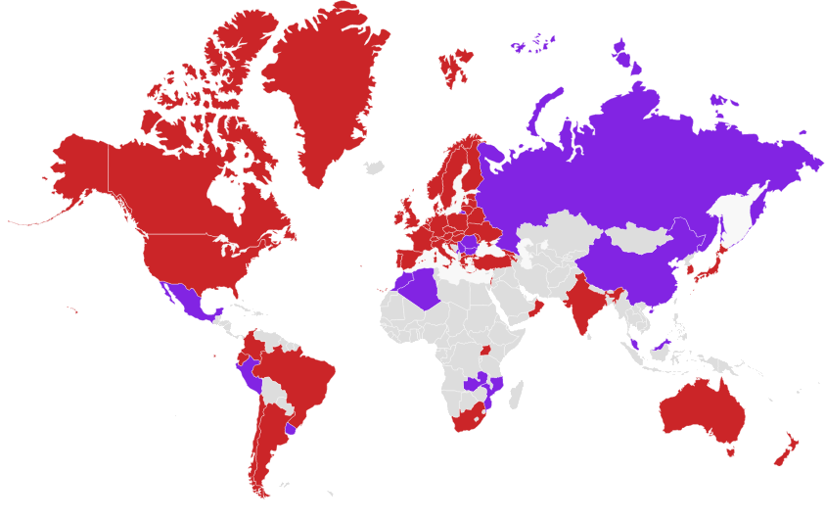
Academic Federations Around the World
https://refeds.org/federations/federations-map, May 2017

Slide 12










SAFIRE – South African Identity Federation
…
https://safire.ac.za/participants/idp/list/ & https://safire.ac.za/participants/sp/list/
Notes:
CSIR, Stellenbosch University (SU), University of Cape Town (UCT), University of the Western Cape (UWC), North-West University (NWU), Nelson Mandela University (NMMU), University of the Witwatersrand (Wits) African Research Cloud (ARC), Square Kilometer Array (SKA), SheerID
DIRISA is in the process of integrating; Sci-GaIA needs to transition

Slide 13

Inter-federation
Inter-federation is the linking of one (academic) federation to another
Through inter-federation we can gain access to services that are not yet available in our own country
Service providers can gain access to customers
Notes:
http://eduGAIN.org/

Slide 14
Integrating SAFIRE with ORCID

Slide 15
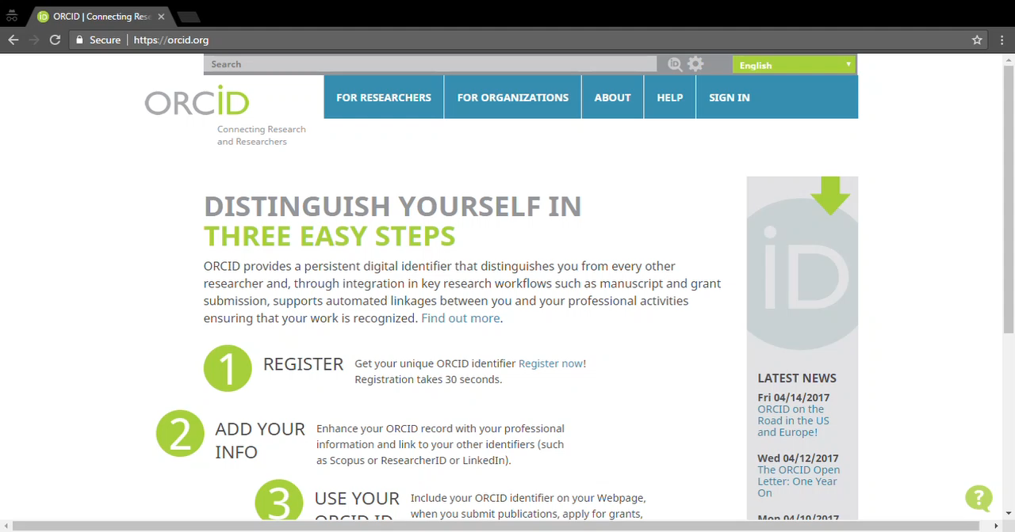
Log into ORCID with an institutional account
Notes:
Demonstrate logging into https://orcid.org/ with an institutional account (UCT)

Slide 16
Integrating ORCID with SAFIRE

Slide 17
Representing ORCID iDs in federation
Federations use a more-or-less standardised set of attributes
An attribute to support ORCID iDs was introduced into the eduPerson specification in February 2016:
eduPersonOrcid
SAFIRE supports eduPersonOrcid
BUT home institutions need to release it!
http://software.internet2.edu/eduperson/internet2-mace-dir-eduperson-201602.html#eduPersonOrcid
https://safire.ac.za/technical/attributes/edupersonorcid/

Slide 18
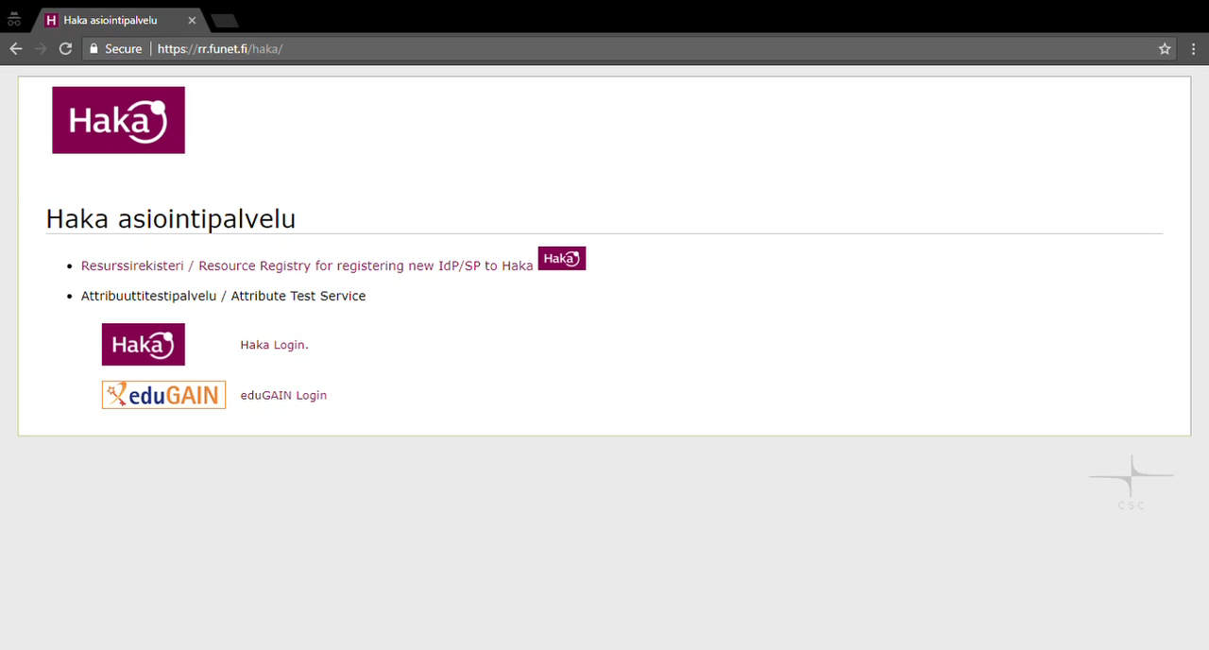
Release your ORCID to other sites
Notes:
Log into https://rr.funet.fi/haka/ via eduGAIN and TENET’s IdP, showing eduPersonOrcid release

Slide 19
Further possibilities

Slide 20

SAFIRE ORCID Attribute Authority
SAFIRE’s hub-and-spoke architecture allows it to augment the information provided by home organisations
This could include allowing individual researchers to link their ORCID iD to an institutional account
BUT this potentially has significant implications for SAFIRE’s privacy policy
And we need to understand how to best leverage this to populate ORCID
So a lot more work is required…
Notes:
Based on an idea from https://wiki.surfnet.nl/display/ORCIDAA/
https://www.linkedin.com/in/brucellino/

